Slide 1
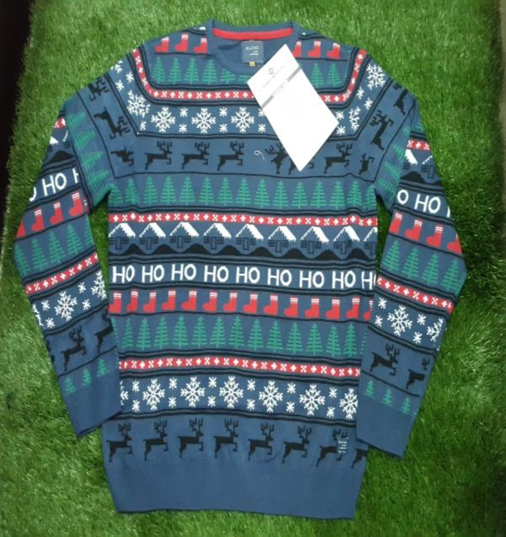
STYLE: PL-17-042
COLOR: GREY, BLUE
QTY: 45 PCS

Slide 2
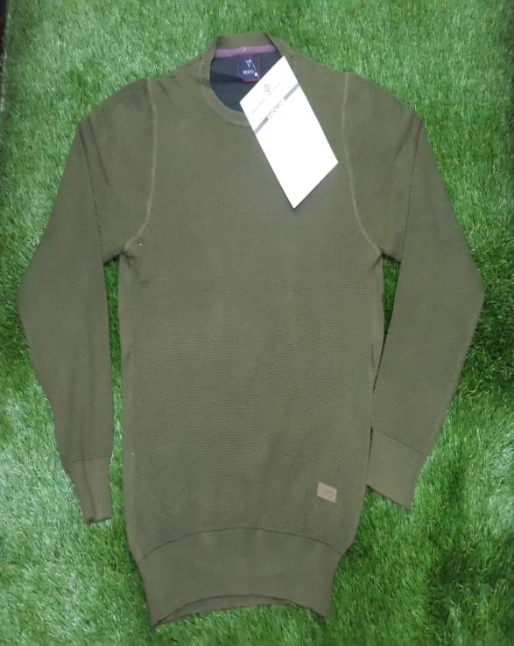
STYLE: PL-17-074
COLOR: GREEN, BLACK, NAVY, CAMEL
QTY: 106 PCS

Slide 3
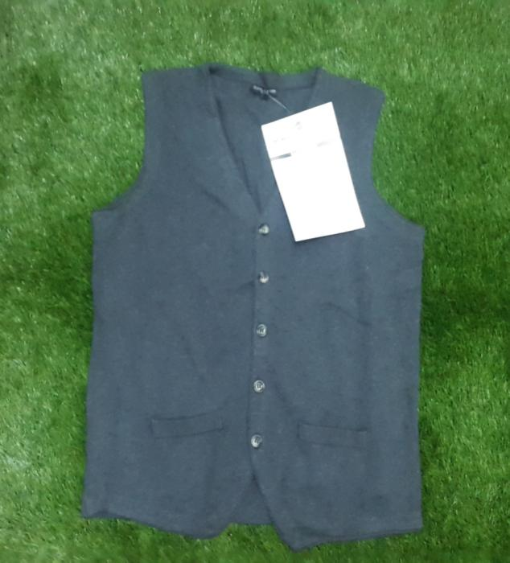
STYLE: PKL-17-208
COLOR: BLACK
QTY: 20 PCS

Slide 4
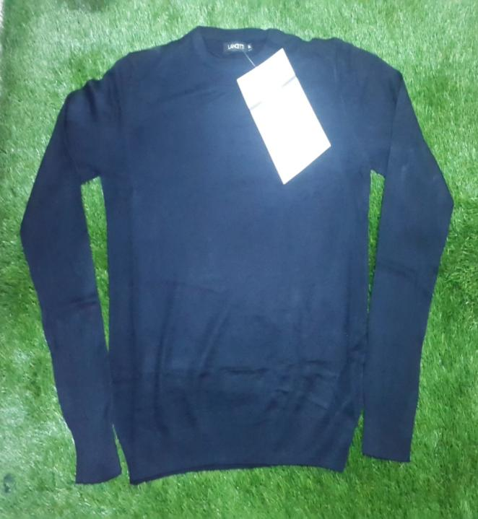
STYLE: PL-17-007
COLOR: NAVY
QTY: 34 PCS

Slide 5
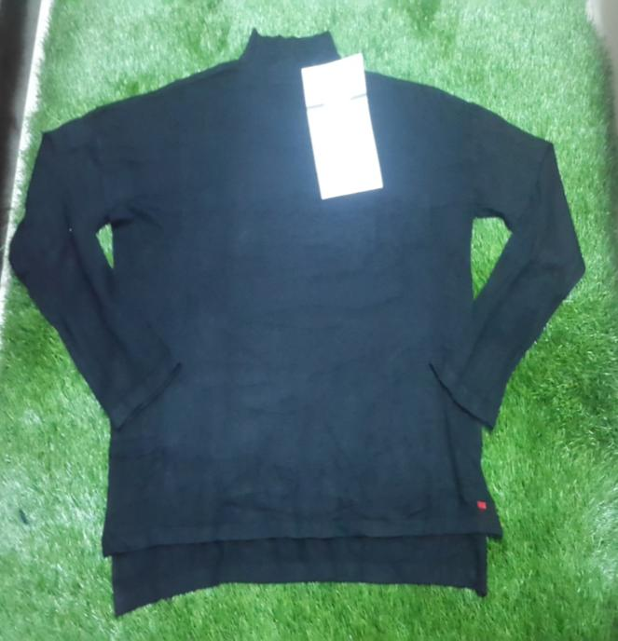
STYLE: PL-17-017
COLOR: BLACK, NAVY, GREEN, BLUE, GREY
QTY: 2876

Slide 6
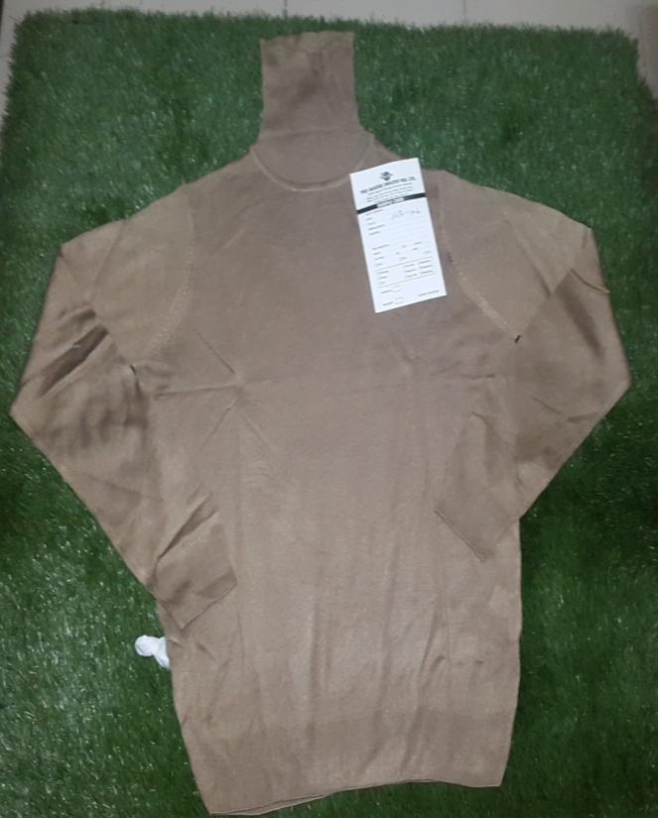
STYLE: PL-17- 076
COLOR: BLACK, NAVY, GREEN, CAMEL
QTY: 378 PCS

Slide 7
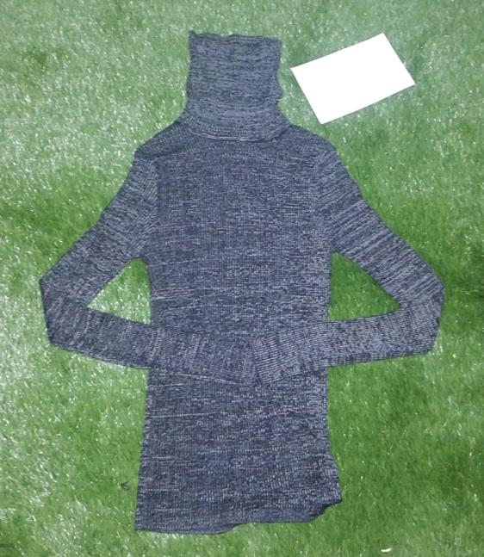
STYLE: PL-17- 085
COLOR: GREY, BLACK
QTY: 200 PCS

Slide 8
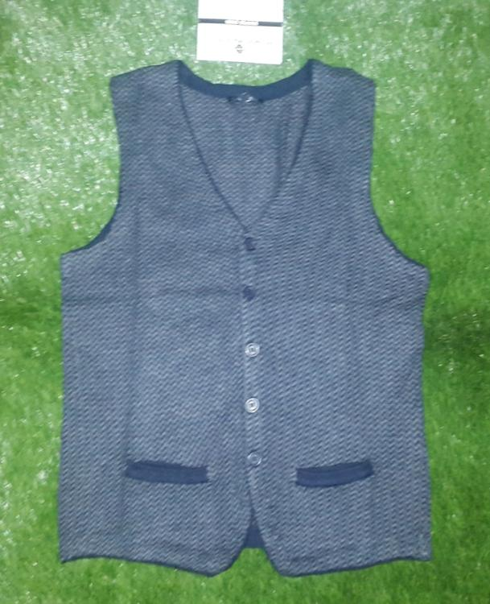
STYLE: PL-17-196
COLOR: DK. GREY
QTY: 47 PCS

Slide 9
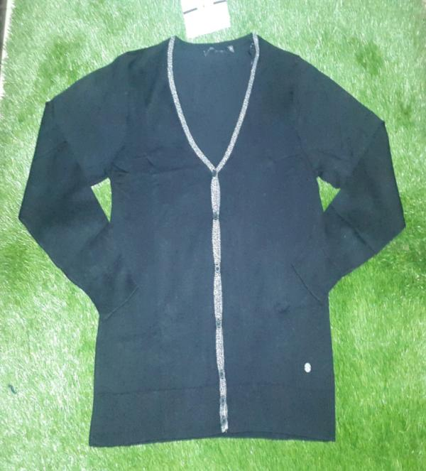
STYLE: PL-17- 187
COLOR: WHITE ,NAVY, BLACK .
QTY: 130 PCS

Slide 10
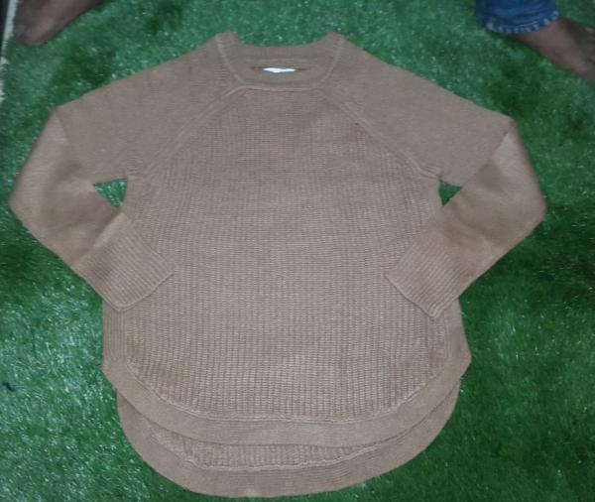
STYLE: PL-17-161
COLOR: WINE,RUST, BROWN, BEIGE, NAVY, GREEN, GREY
QTY: 1076 PCS

Slide 11
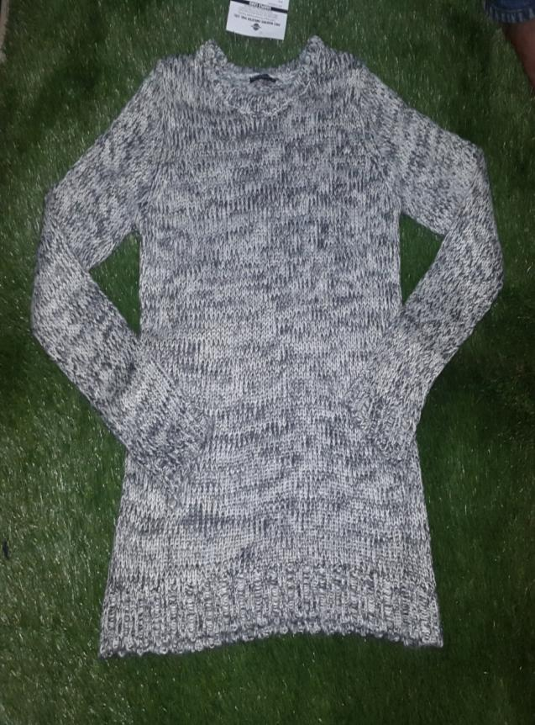
STYLE: PL-17-110
COLOR: BLACK , GREY GREEN
QTY: 193 PCS

Slide 12
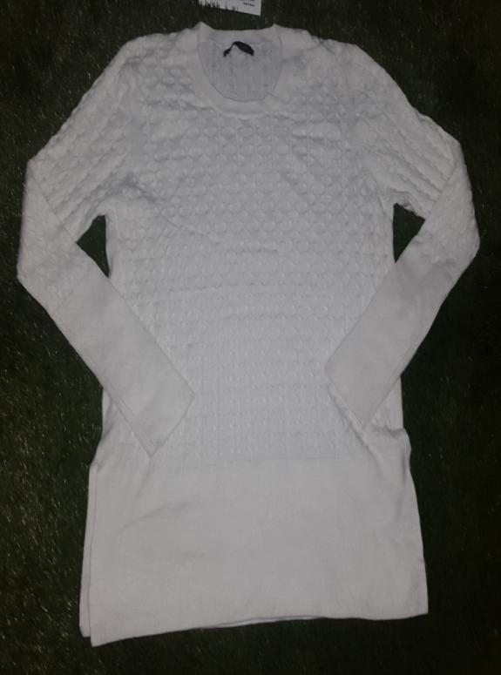
STYLE: PL-17-199
COLOR: WHITE, NAVY
QTY: 184 PCS

Slide 13
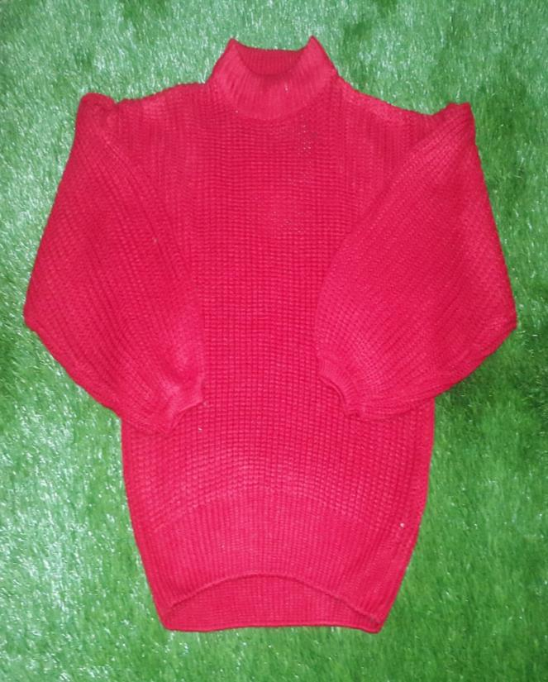
STYLE: PL-17-232
COLOR: RED, GREY, WHITE
QTY: 381 PCS

Slide 14
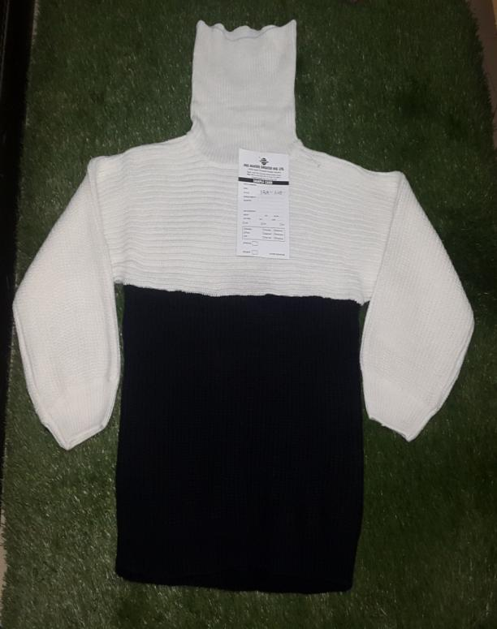
STYLE: PL-17-229
COLOR: WHITE/BLACK
QTY: 122 PCS

Slide 15
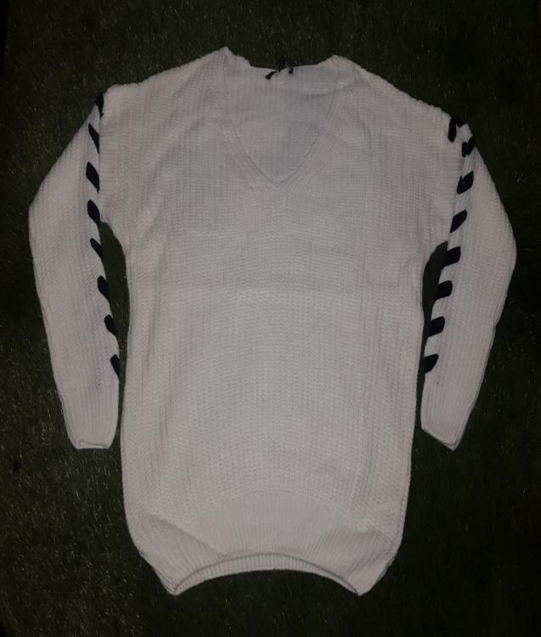
STYLE: PL- 17-230
COLOR: WHIT, GREY, BEIGE, NAVY, BLACK
QTY: 742 PCS

Slide 16
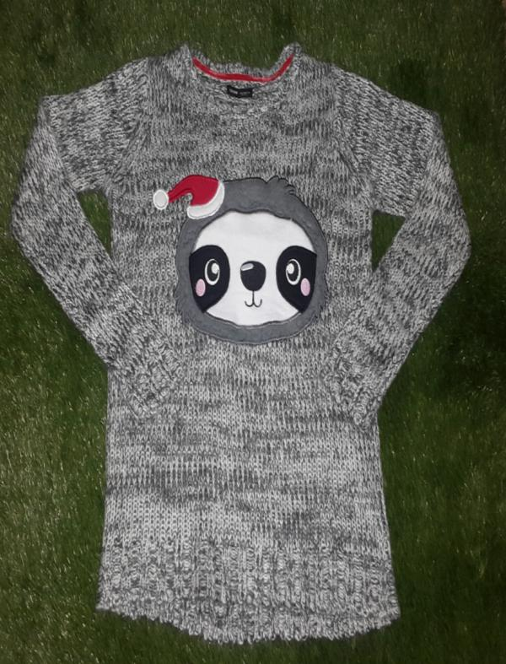
STYLE: PL-17-278
COLOR: BLACK, WHITE
QTY: 73 PCS

Slide 17
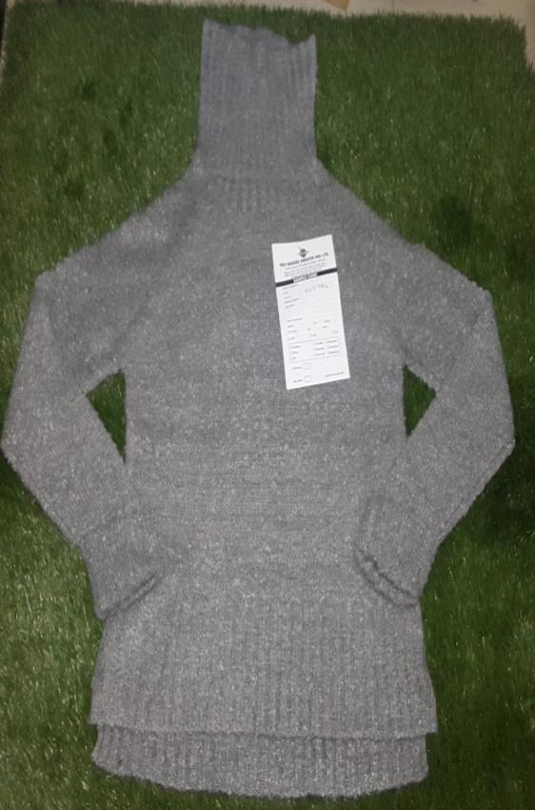
STYLE: PL-17-086
COLOR: RUST, GREY
QTY: 191 PCS

Slide 18
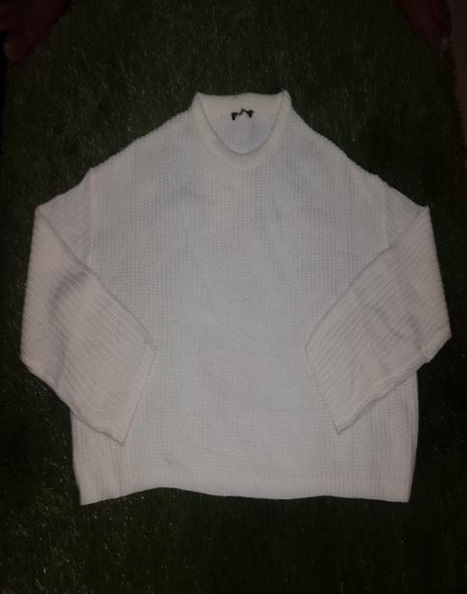
STYLE: PL-17-224
COLOR: WHITE, PINK, BLUE, BLACK
QTY: 416 PCS

Slide 19
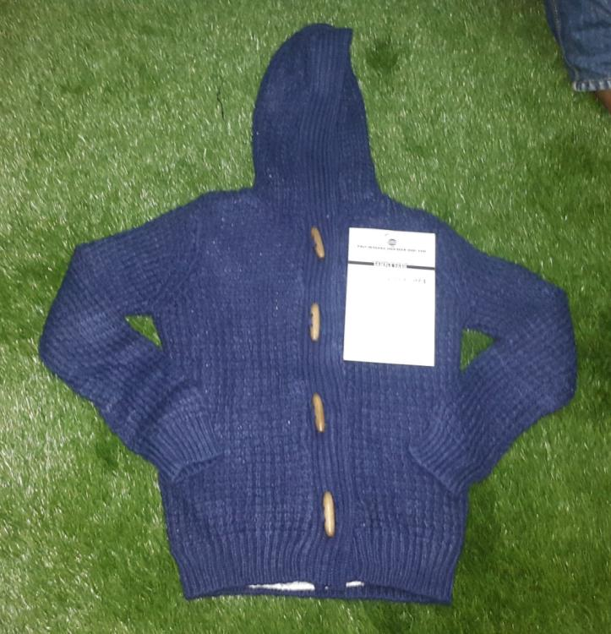
STYLE: PL-17-027
COLOR: PINK, WHITE, GREY, BLUE
QTY: 521 PCS

Slide 20
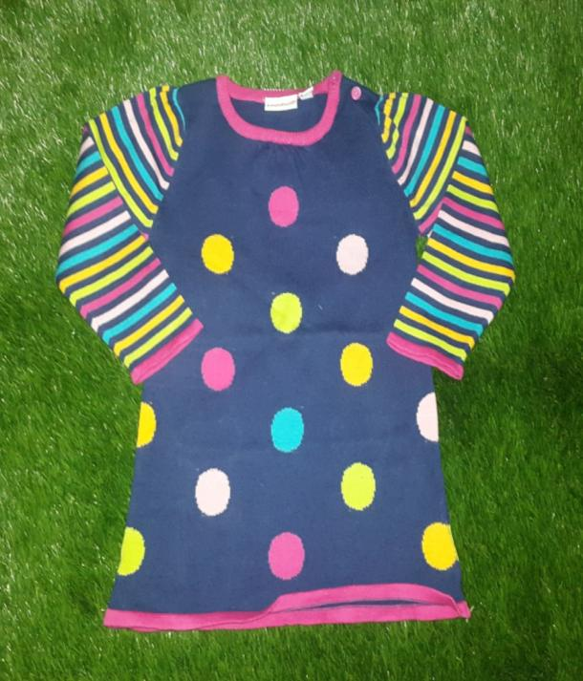
STYLE: PL-17-078
COLOR: NAVY
QTY: 758 PCS

Slide 21
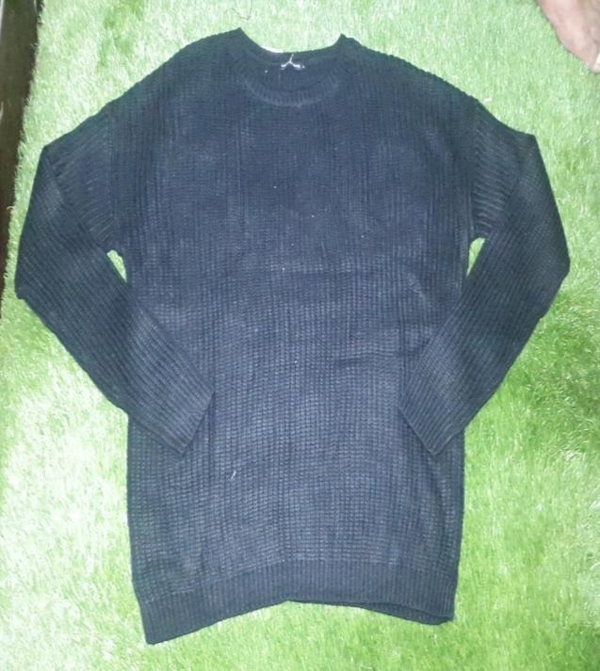
STYLE: PL-17-227
COLOR: BLACK ,PINK
QTY: 580 PCS

Slide 22
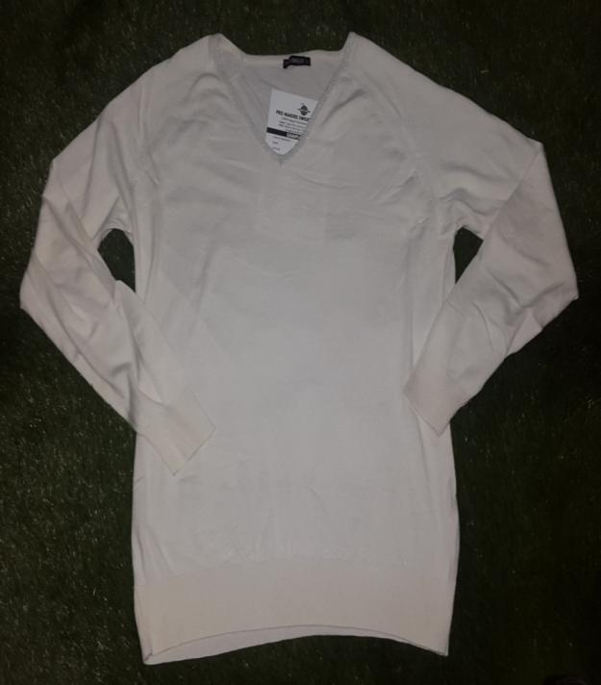
STYLE: PL-17-188
COLOR: BLACK ,DK GREY, WHITE .
QTY: 411 PCS

Slide 23
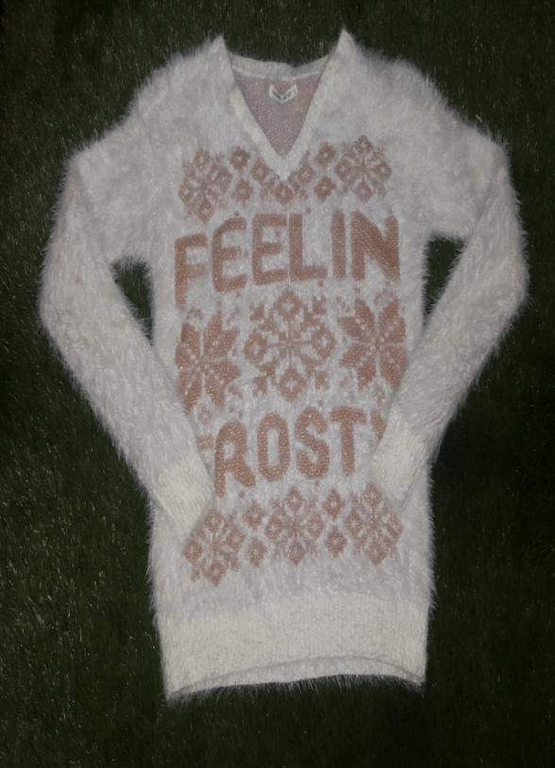
STYLE: PL-17-272
COLOR: WHITE
QTY: 125 PCS

Slide 24
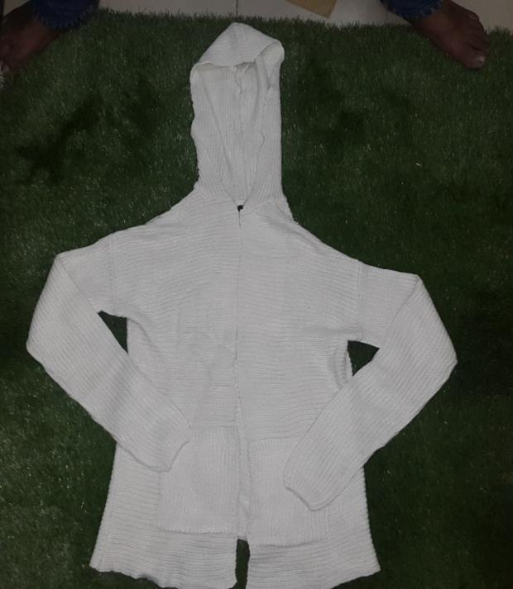
STYLE: PL-17-204
COLOR:WHITE, BLACK
QTY:1110 PCS

Slide 25
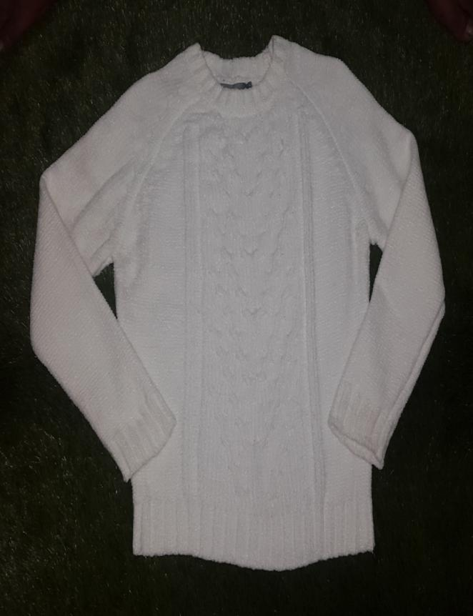
STYLE: PL-17- 010 A
COLOR: BLACK, BLUE, PINK, WHITE, PURPLE, GREEN, GREY , BROWN
QTY: 487 PCS

Slide 26
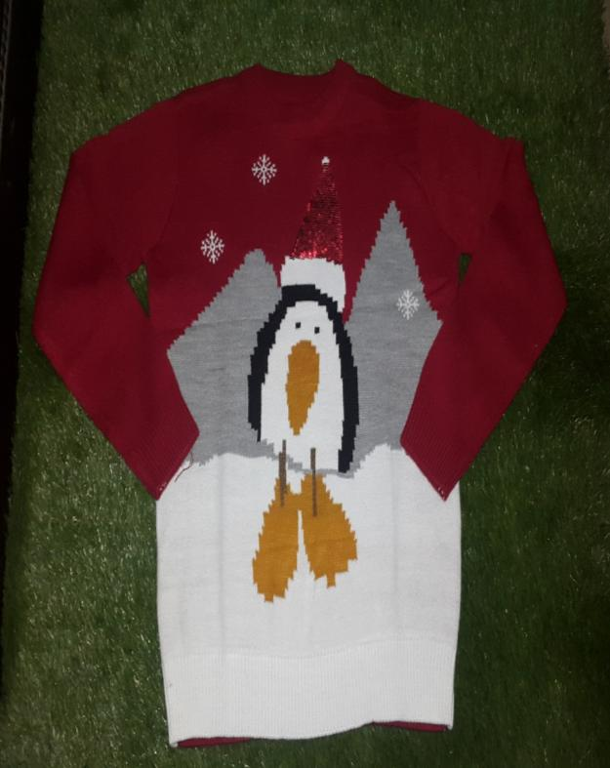
STYLE: PL-17-047
COLOR: RED
QTY: 62 PCS

Slide 27
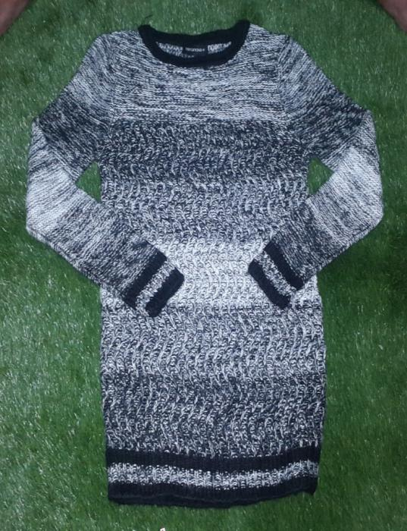
STYLE: PL-17-036
COLOR: BLACK, BORDEX
QTY: 624 PCS

Slide 28
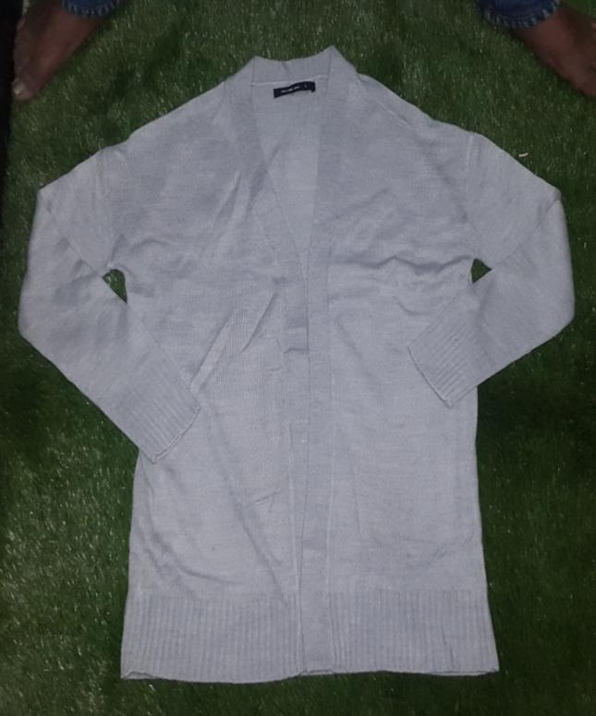
STYLE: PL-17-037 A
COLOR: BLACK ,WHITE, YELLOW,GREEN,NAVY, BORDEX,
QTY: 1792PCS

Slide 29
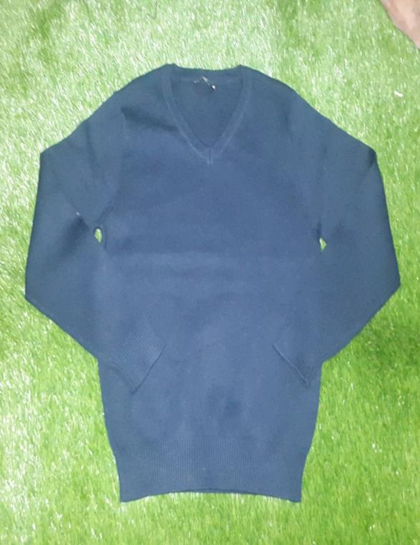
STYLE: PL-17-105
COLOR: BLACK
QTY: 40 PCS

Slide 30
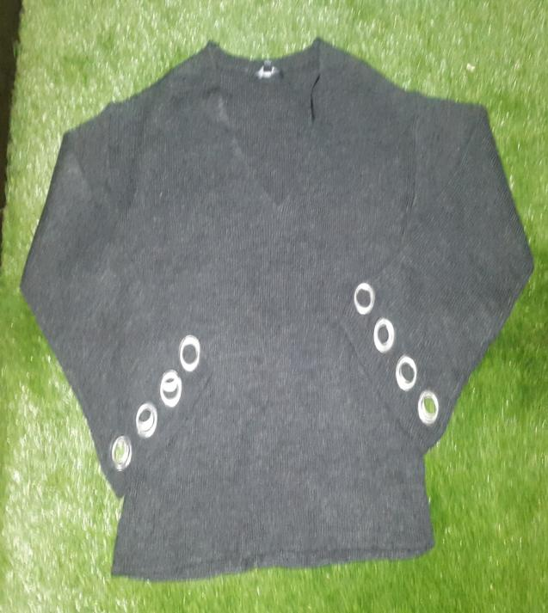
STYLE: PL-17-100
COLOR: GREY
QTY: 120 PCS

Slide 31
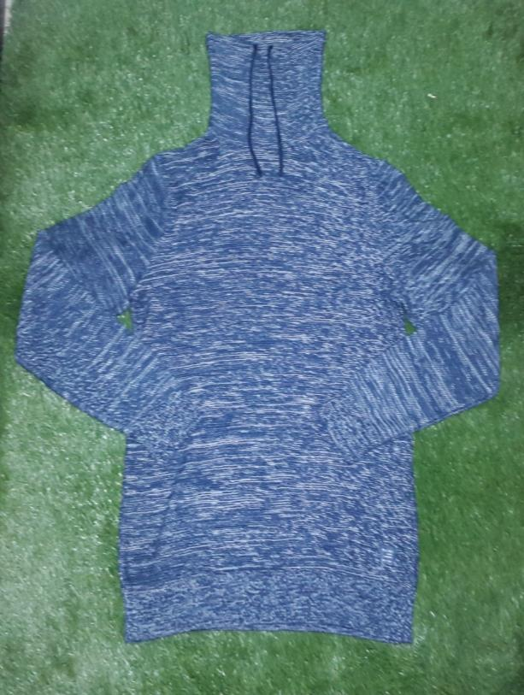
STYLE: PL-17-006
COLOR: NAVY/BLACK
QTY: 50 PCS

Slide 32
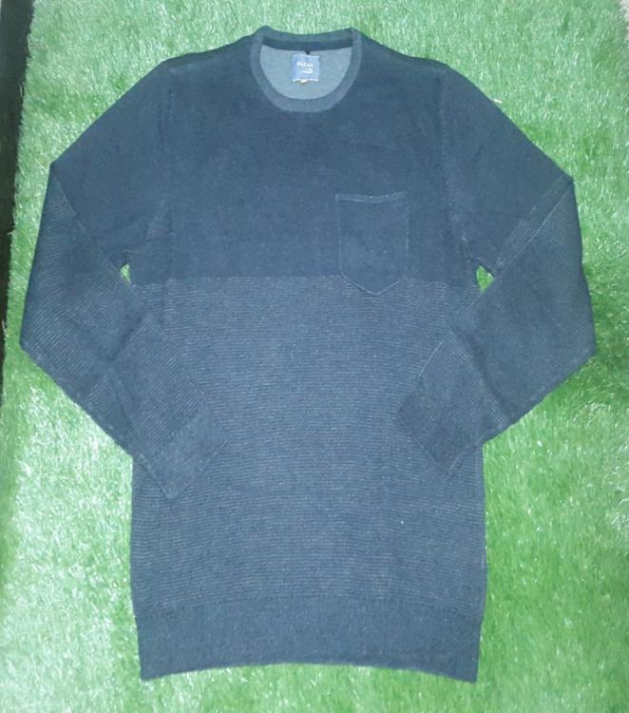
STYLE: PL-17-004
COLOR: NAVY
QTY: 469 PCS

Slide 33
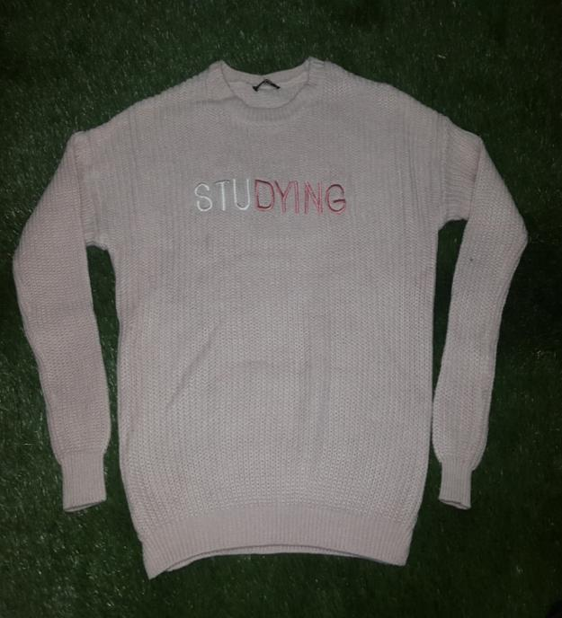
STYLE: PL-17- 055
COLOR: PINK, WHITE, BLACK, RED
QTY: 2725 PCS

Slide 34
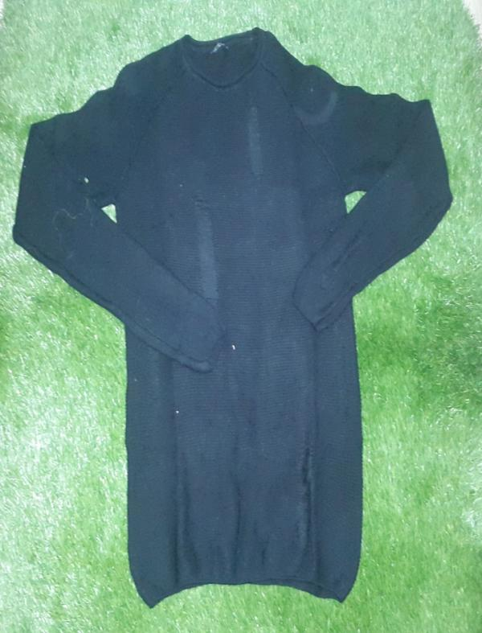
STYLE: PL-17-013
COLOR: BLACK
QTY: 70 PCS

Slide 35
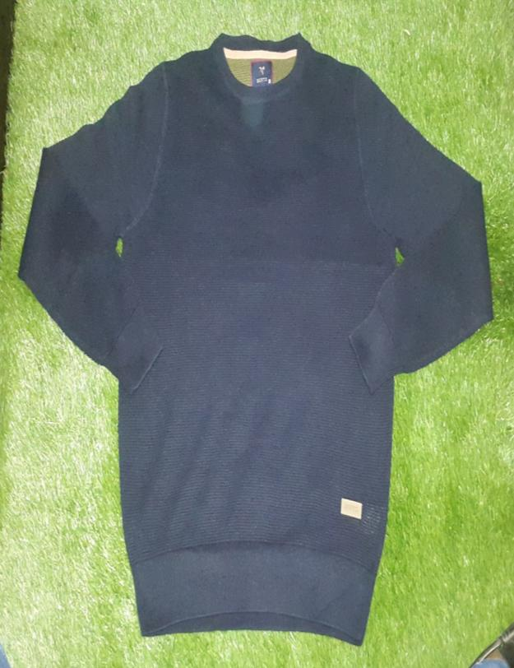
STYLE: PL-17-138
COLOR: BLACK
QTY: 115 PCS

Slide 36
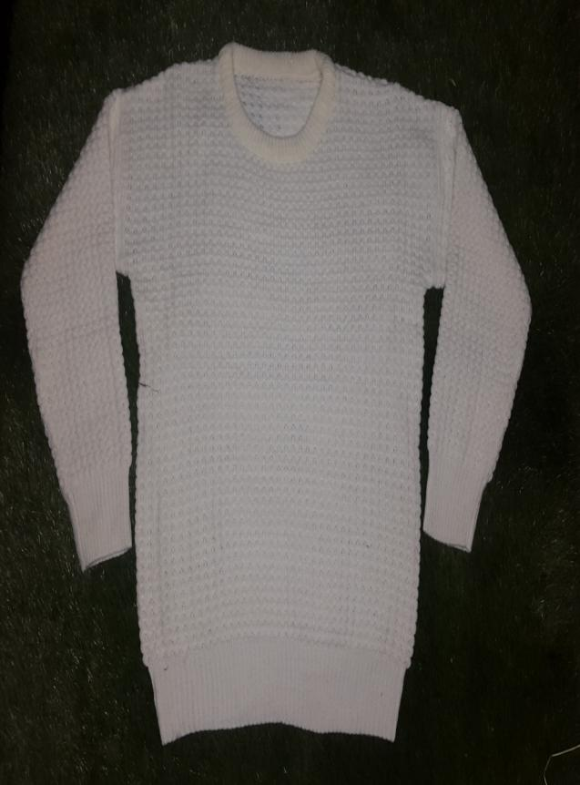
STYLE: PL-17-228
COLOR: WHITE
QTY: 118 PCS

Slide 37
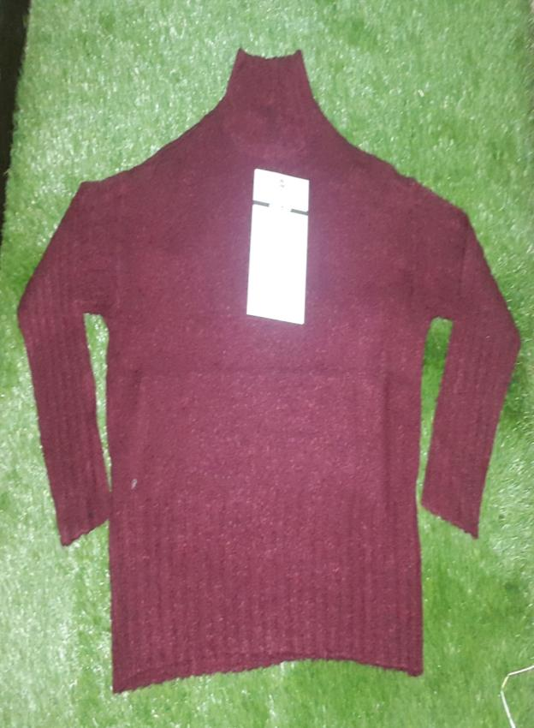
STYLE: PL-17-092
COLOR: WINE, GREY, BORDEX
QTY: 72 PCS

Slide 38
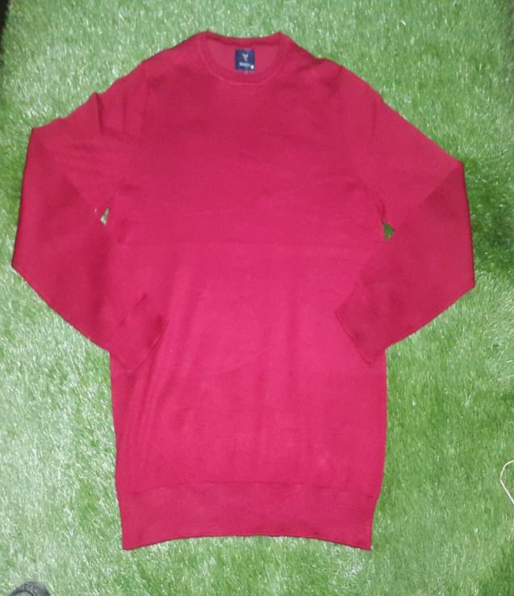
STYLE: PL-17-079
COLOR: BLACK, WINE, ROSE
QTY: 145 PCS

Slide 39
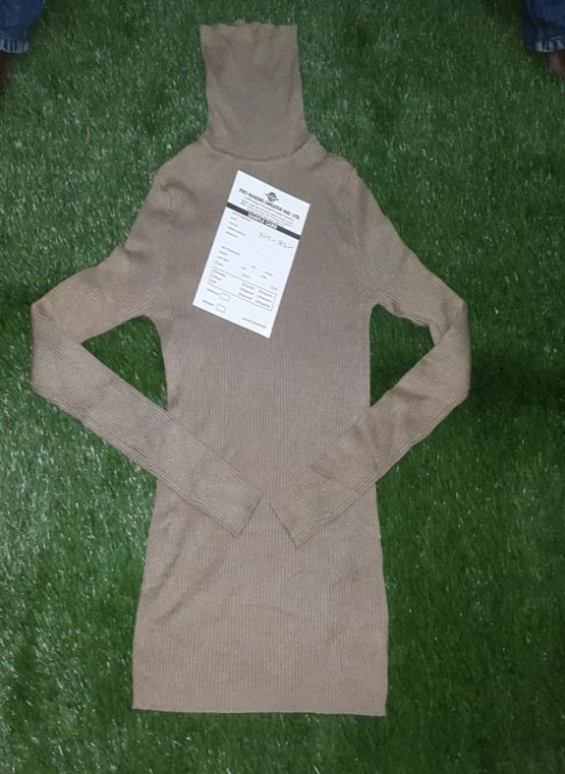
STYLE: PL-17- 016
COLOR: NAVY, CAMEL, BLACK, BLUE, GREY, GREEN
QTY: 2543 PCS

Slide 40
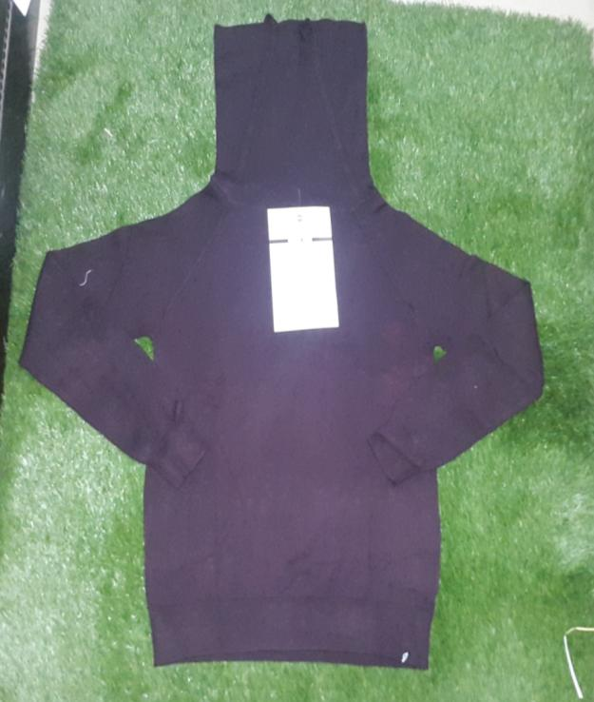
STYLE: PL-17- 122
COLOR: BLACK , GREY , BORDEAUX
QTY: 144 PCS

Slide 41
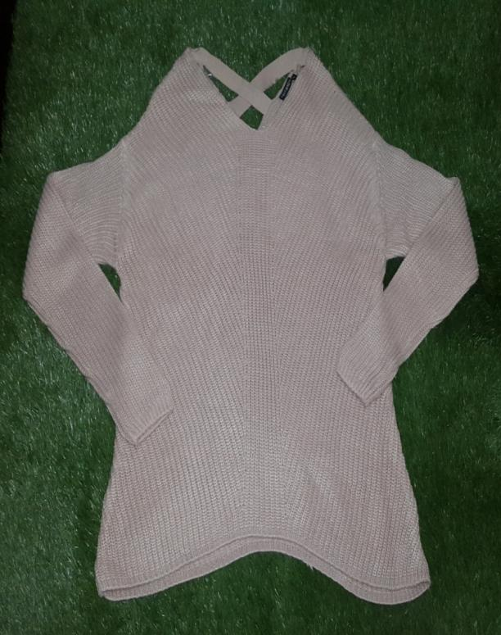
STYLE: PL-17-223
COLOR: PINK
QTY: 46 PCS

Slide 42
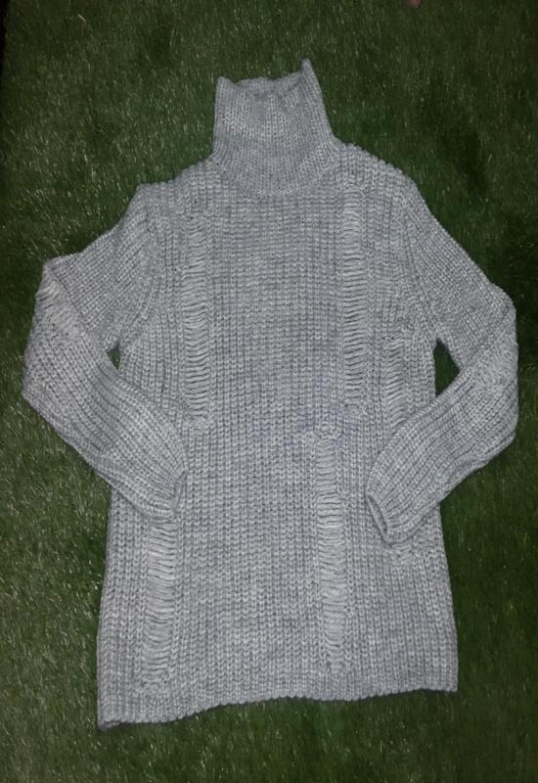
STYLE: PL-17-203
COLOR: GREY
QTY: 20 PCS

Slide 43
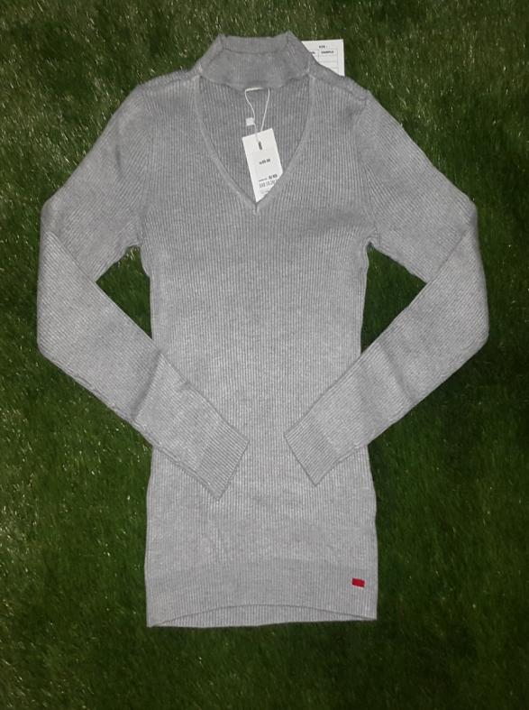
STYLE: PL-17-095
COLOR: GREY
QTY: 90 PCS

Slide 44
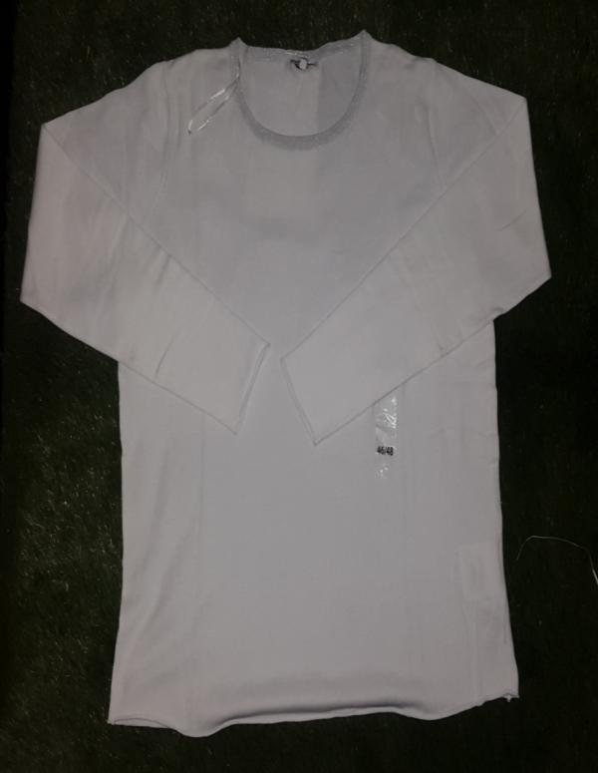
STYLE: PL-17-181
COLOR: WHITE, BLUE, YELLOW
QTY: 495 PCS

Slide 45
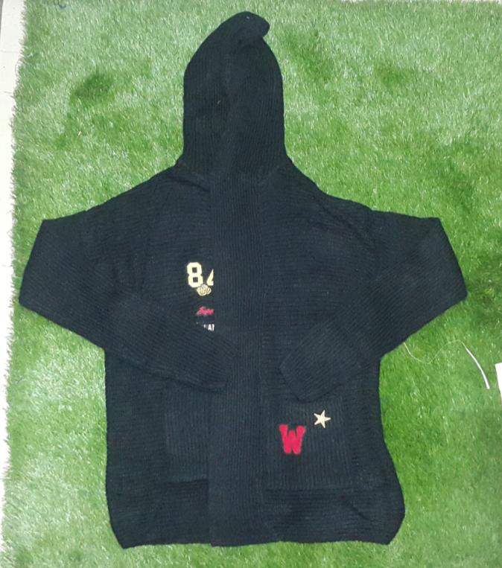
STYLE: PL-17-032
COLOR: BLACK
QTY: 32 PCS

Slide 46
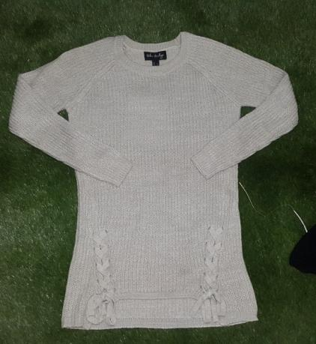
STYLE: PL-17-030
COLOR: BIAHT
QTY: 40 PCS

Slide 47
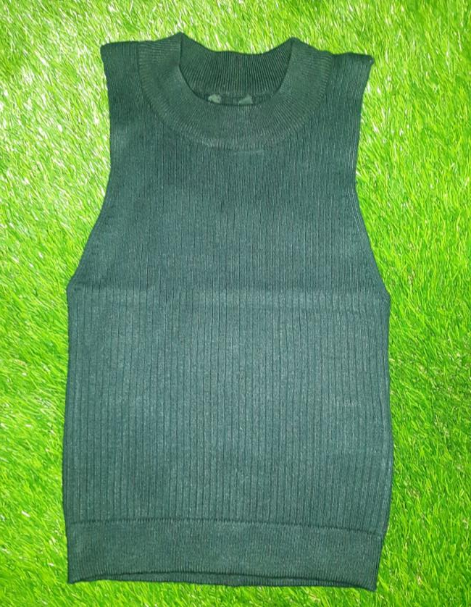
STYLE: PL-17-098
COLOR: BLACK, PINK
QTY: 160 PCS

Slide 48
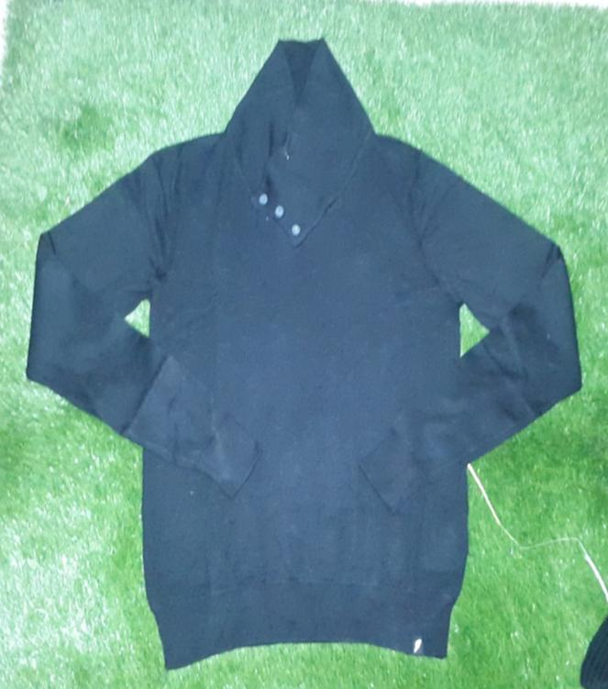
STYLE: PL-17-108
COLOR: BLACK, WHITE, GREEN
QTY: 164 PCS

Slide 49
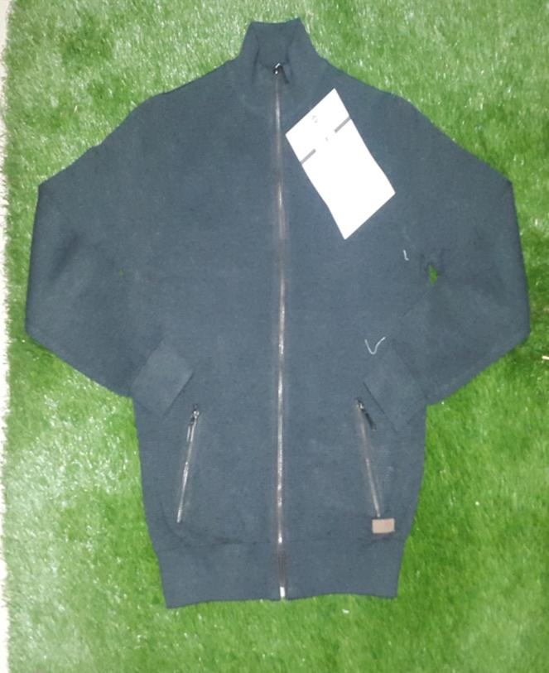
STYLE: PL-17-145
COLOR: NAVY
QTY: 42 PCS

Slide 50
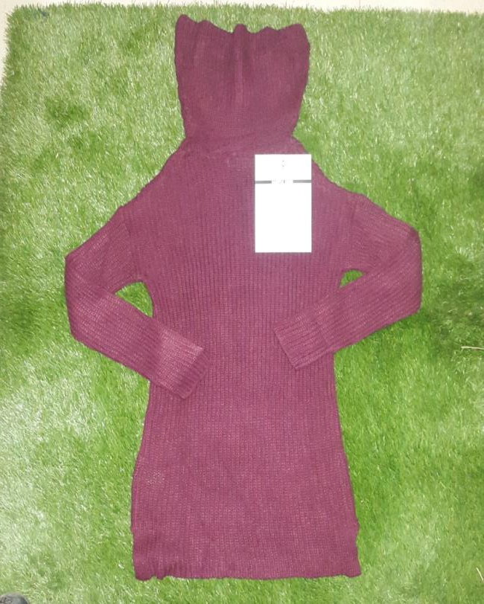
STYLE: PL-17-225
COLOR: PINK, WHITE, BLUE
QTY: 87 PCS

Slide 51

STYLE: PL-17-046
COLOR: RED, NAVY
QTY: 150 PCS

Slide 52

STYLE: PL-17-084
COLOR: RED, BLUE
QTY: 32 PCS

Slide 53

STYLE: PL-17-057
COLOR: RED
QTY: 12 PCS

Slide 54

STYLE: PL-17-034
COLOR: PINK, GREEN, BLACK
QNTY: 1018 PCS

Slide 55

STYLE: PL-17-016
COLOR: NAVY, CAMEL, BLACK, BLUE, GREY, GREEN
QTY: 2543 PCS

Slide 56

STYLE: PL- 17-294
COLOR: NAVY
QTY: 70 PCS

Slide 57

STYLE: PL-17-015
COLOR: GREY
QTY: 9 PCS

Slide 58

STYLE: PL-17-214
COLOR: BLACK, PINK, WHITE, MINT
QTY: 1517 PCS

Slide 59

STYLE: PL-17-002
COLOR: BLACK, WHITE, ORANGE, MINT
QTY: 833 PCS

Slide 60

STYLE: PL-17-033
COLOR:GREY ,NAVY ,BLACK
QTY: 294 PCS

Slide 61

STYLE: PL-17-124
COLOR:WHITE ,GREY
QTY: 46 PCS

Slide 62

STYLE: PL-17-186
COLOR: BLACK, NAVY, WHITE
QTY:326 PCS

Slide 63

STYLE: PL-17-035
COLOR: BLACK , GREEN, BORDEAUX
QTY: 1212 PCS

Slide 64

STYLE: PL-17-064
COLOR: MARINE, GREY
QTY: 2504 PCS

Slide 65

STYLE: PL-17-107
COLOR: RED, BLACK
QTY:242 PCS

Slide 66

STYLE: PL-17-031
COLOR: RED, WHITE, BLACK, GREY, PINK
QTY:365 PCS

Slide 67

STYLE: PL-17-139
COLOR: GREY
QTY: 89 PCS

Slide 68

STYLE: PL-17-106
COLOR: BLACK, GREY, PINK
QTY: 317 PCS

Slide 69

STYLE: PL-17-200
COLOR: BLACK , GREY
QTY: 346 PCS

Slide 70

STYLE: PL-17-215
COLOR: BLACK
QTY: 9 PCS

Slide 71

STYLE: PL-17-211
COLOR: BLACK
QTY: 38 PCS

Slide 72

STYLE: PL-17-084
COLOR: WHITE,GREY,BLACK
QNTY: 527 PCS

Slide 73

STYLE: GOCCO
COLOR: BROWN
QNTY: 142 PCS

Slide 74

STYLE:
COLOR: WHITE , PINK, BLACK
QNTY: 142 PCS

Slide 75

STYLE: DAEYU BAN - 1
COLOR: GREY, PINK, NAVY
QNTY: 764 PCS

Slide 76

STYLE: PL-17-162
COLOR: BLACK, CAMEL, GREEN, IVORY, GREY, WHITE
QNTY: 1805 PCS

Slide 77

STYLE: PL-16-182
COLOR: WHITE
QNTY: 200 PCS

Slide 78

STYLE: PL-16-084
COLOR: WHITE, PINK
QNTY: 760 PCS

Slide 79

STYLE: PL-16-173
COLOR: BLACK , NAVY, PINK
QNTY: 400 PCS

Slide 80

STYLE: FRANCA
COLOR: GREY, BLACK
QNTY: 500 PCS

Slide 81

STYLE: JM EXPORT
COLOR: GREY, WHITE
QNTY: 700 PCS

Slide 82

STYLE: KALIM TEX
COLOR: GREY
QNTY: 1200 PCS

Slide 83

STYLE: KALIM TEX
COLOR: BLUE
QNTY: 1200 PCS

Slide 84

STYLE: KALIM TEX
COLOR: GREY
QNTY: 1200 PCS

Slide 85

STYLE: D.FASHION
COLOR: BLUE
QNTY: 3200 PCS

Slide 86

STYLE: PL-17-025
COLOR: BLACK, GREY
QNTY: 3800 PCS

Slide 87

STYLE: PL-17-003
COLOR: NAVY TWIST
QNTY: 1030 PCS

